Slide 1
Second phase update

Slide 2
Wrap up for first phase

Slide 3
General Idea
Building as more as possible for users – doing ‘deletion’ during development
Modularized build-up, always possible to add more if needed
Maximum flexibility with recommended default setting
Generating report for visualization and data performance check, thus people knows what is the output explicitly
Opening for future, all the output in a format can be further utilized for future studies

Slide 4
Clustering
Cluster the features based on behavior (proper normalization & standardization needed)
Remove noises based on cluster information
Visualize the cluster result for validation & save the result as matrix effect/chemical property tracker

Slide 5
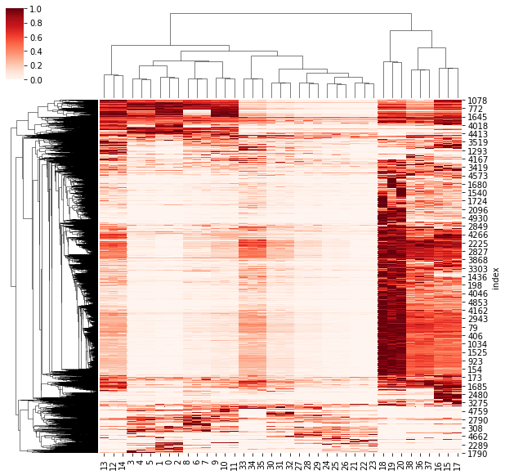

Slide 6
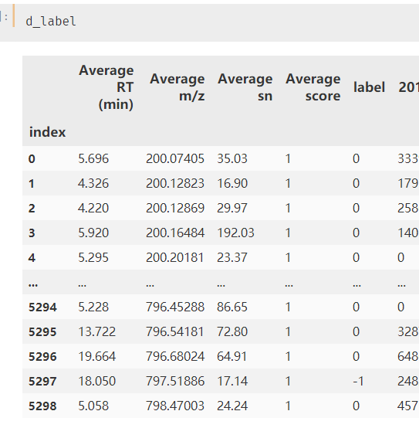

Slide 7
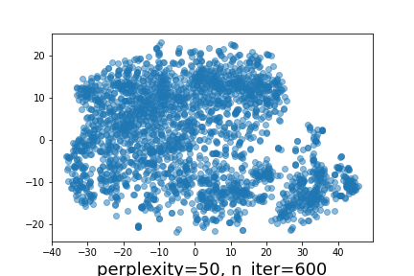
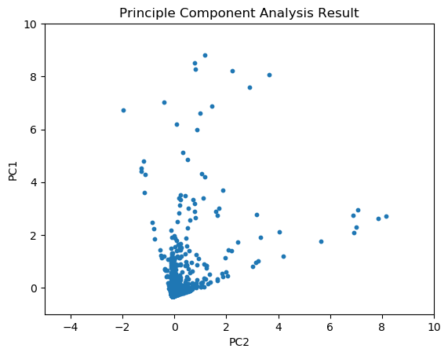

Slide 8
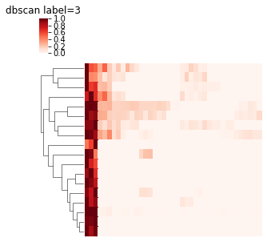
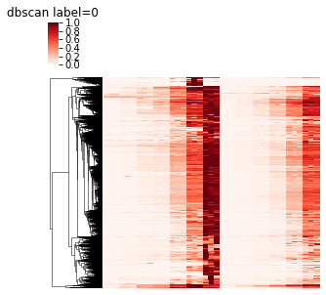
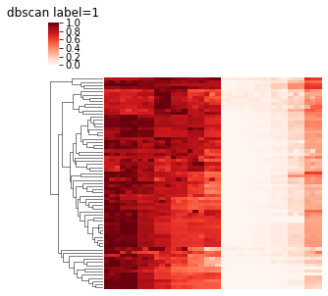
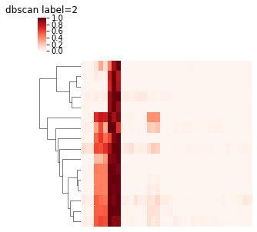
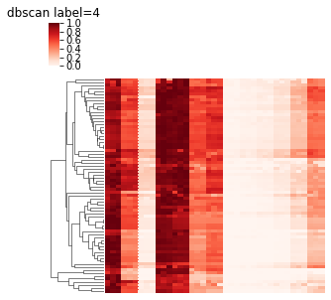
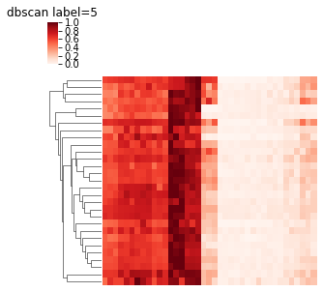
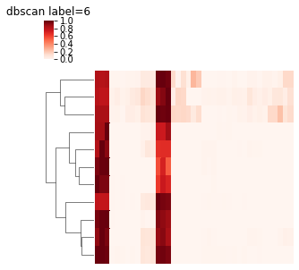
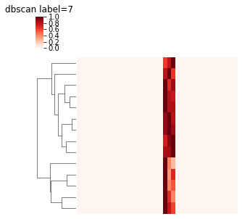
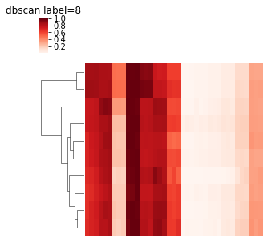
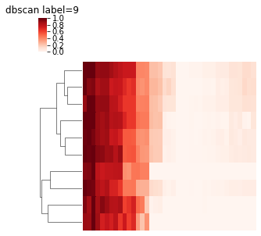
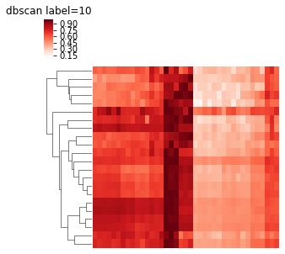
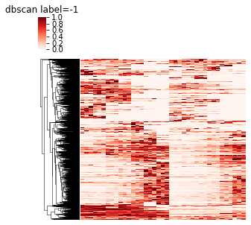

Slide 9
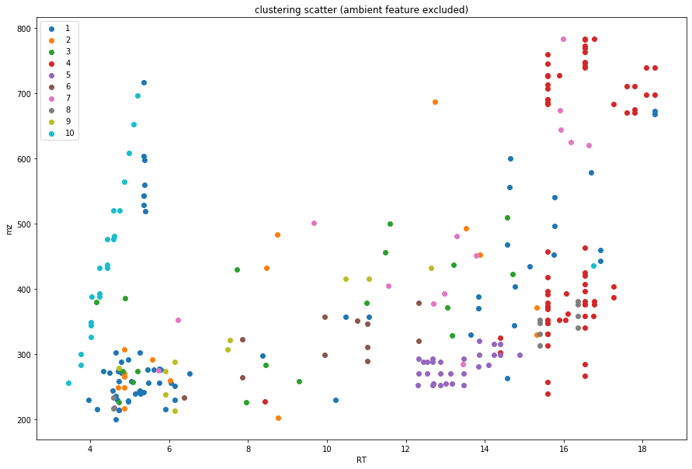

Slide 10
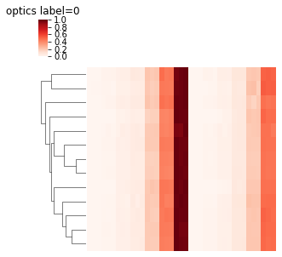
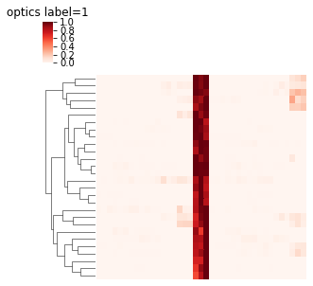
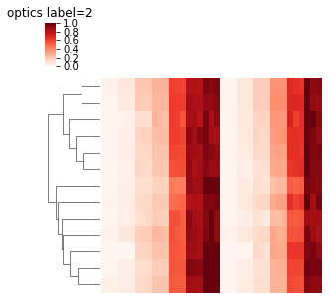
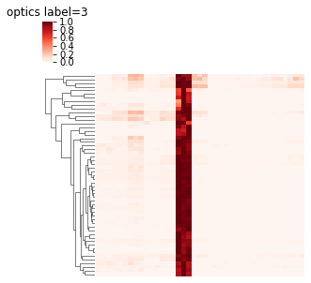
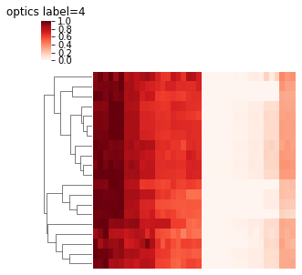
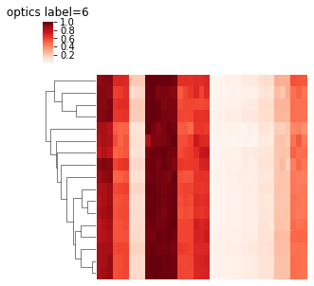
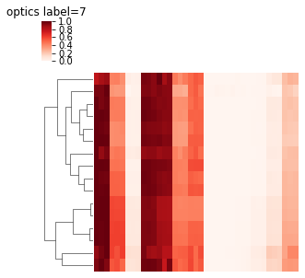
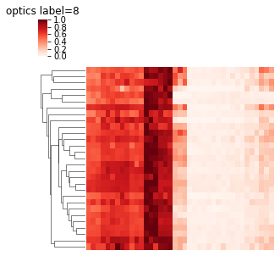
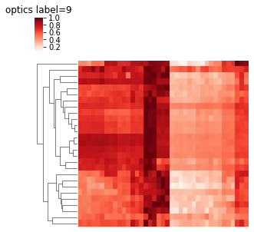
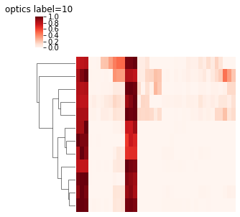
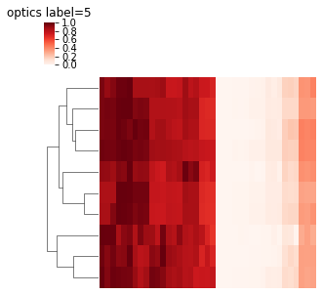
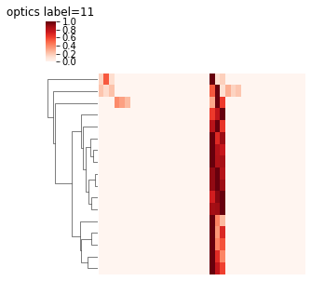
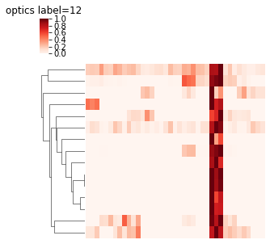
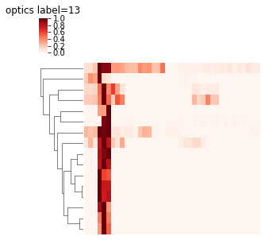
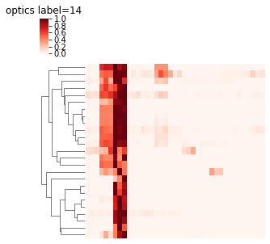
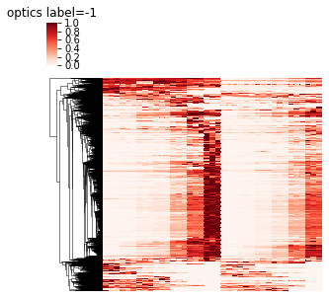

Slide 11
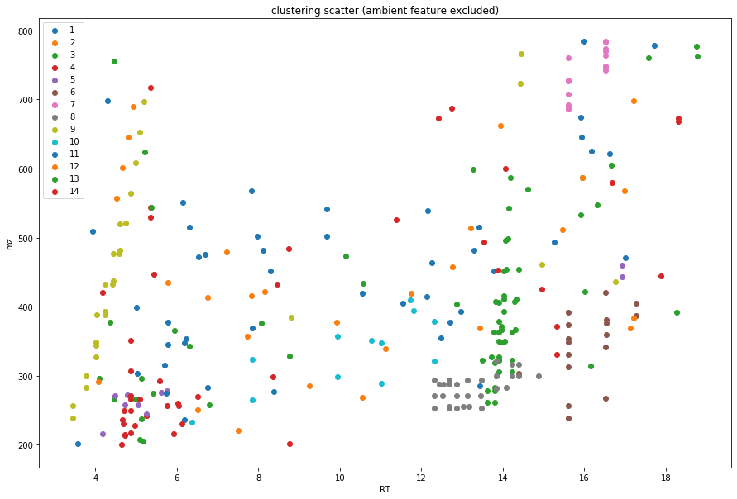

Slide 12
Modeling
Build model based on dilution dataset and cluster information
More accurate dilution rate prediction based on selected feature entity rather than single one
Save the model for clusters which could be used for matrix effect assessment
Only used source feature – make it possible to do approximate dilution calc based on even environmental samples

Slide 13
Options for user -- flowchart
Input: dilution data
Output:
general model for the data, separate model for each cluster(if the method selected) – sudo code:
if nocluster, model=all model; if cluster, model=[allmodel, model1, model2, model…]
Model report (RSEtraining vs RSEtesting, bias and etc.)
Model report 2 summary on separate models

Slide 14
General function
Rf/lasso/other
Linear regression
Use cluster
Use cluster
Use all features
Use all features
Ensemble method
Separate model information & report
Separate model information & report
Performance report
Performance report
Performance report
Merged model
Merged model

Slide 15
Quick source ID based on Venn diagram idea

Slide 16
Flow chart for source ID process
Pretreat
Calculate means and CV from triplicates
Label
Labeling the features according to peak area threshold
ID and prem track
Using the label for preliminary ID and area tracking
Define mixture/source samples
Source & feature tracking (future)
Combine the information from the modeling data and cluster information

Slide 17
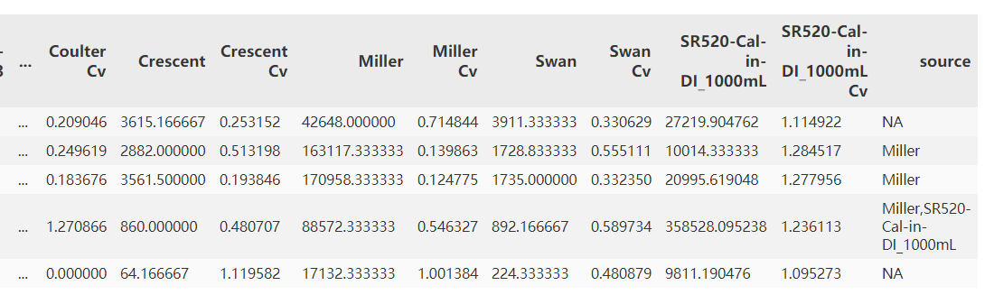

Slide 18
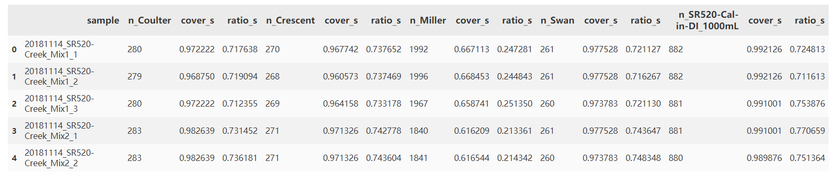
Text explanation for each column here

Slide 19
documentation

Slide 20
testing

Slide 21
Tasks to solve
Validation on larger dataset
Method optimization

Slide 22
Next & future dev

